Slide 1

Mini Project-I (K24MCA18P) Odd Semester Session 2024-25
Restaurant Management System
Shalini Mishra 2426mca1999
Priyam Sharma2426mca
Ram Dubey2426mca
Project Supervisor:
Miss Divya Singhal

Slide 2
Content
1) Introduction
2) Literature Review
3) Objectives
4) Technology
5) Modules
6) Work-flow
7) Reports
Notes:
Font Styles: Times New Roman + Font Size: 25

Slide 3
Introduction
The Restaurant Management System (Frontend Only) is a web application that allows customers to interact with the restaurant's services through a responsive and intuitive interface. Key features include browsing the menu, adding items to a cart, managing orders, and reserving tables, all with a smooth and interactive user experience. The application uses local data storage for cart management and offers a mock checkout process. It is designed purely with frontend technologies, focusing on responsive design, user interaction, and client-side functionality without backend and integration.
Notes:
Font Styles: Times New Roman + Font Size: 25

Slide 4
Literature Review
The frontend of a restaurant management system plays a critical role in delivering a seamless and intuitive user experience. Recent advancements in frontend technologies like React.js have made it easier to develop dynamic and responsive interfaces. These frameworks enable the creation of Single Page Applications that provide smooth user interactions, crucial for features such as browsing menus, managing carts, and making table reservations.
Responsive design has become a standard in frontend development. As research shows, the majority of restaurant customers prefer accessing online services via mobile devices, making responsiveness a key factor in user retention.
Notes:
Font Styles: Times New Roman + Font Size: 25

Slide 5
Objective of the Project
The objective of this project is to develop a Restaurant Management System using frontend technologies to provide a seamless and responsive user interface. It aims to enable customers to browse menus, manage orders, reserve tables, and simulate a checkout process, all through an interactive, mobile-friendly platform. The system will utilize React.js for dynamic content rendering, CSS frameworks for responsive design, and LocalStorage for managing client-side data without backend integration.
Notes:
Font Styles: Times New Roman + Font Size: 25

Slide 6
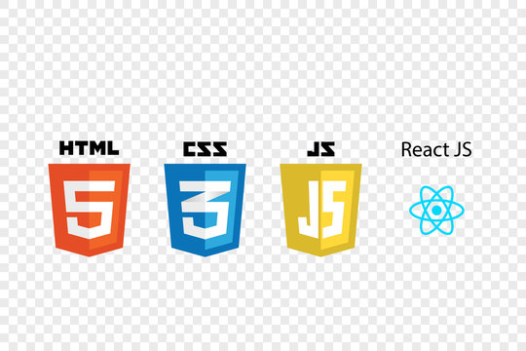
Technology
Frontend Technologies:
Notes:
Font Styles: Times New Roman + Font Size: 25

Slide 7
Technology
Frameworks: React.js
Styling: CSS
Tools used : Figma
Data Storage: LocalStorage for managing cart and reservation data.
Notes:
Font Styles: Times New Roman + Font Size: 25

Slide 8
Modules
1 Home Module:
Acts as the landing page with a restaurant overview, navigation links, featured dishes, and call-to-action buttons.
2 Menu Module:
Displays the restaurant's menu categorized by sections (e.g., appetizers, main courses) with item details, images, prices, and an "Add to Cart" feature.
3 Cart Module:
Manages selected menu items, showing individual prices and a total cost, along with options to adjust quantities and remove items.
4 Order Summary Module:
Provides a final review of the order with customer detail input fields and a mock payment option before confirming the order.
Notes:
Font Styles: Times New Roman + Font Size: 25

Slide 9
Modules (Contd.)
5 Table Reservation Module:
Allows customers to reserve tables by filling out a form with details like date, time, and number of guests.
6. About Us Module:
Shares information about the restaurant's history, mission, and team.
7. Contact Us Module:
Enables customers to reach out via a contact form and displays contact information.
8. Feedback and Review Module (Optional):
Allows customers to submit reviews and ratings for menu items.
9. Loading and Error Handling Module:
Provides visual feedback during data loading and displays error messages for failed actions.
10.Customer Relationship Module : Collect and manage customer data, including order history and prefences .
Allow for personalized offers, loyalty programs and promoation .
Send notification for deals discounts, or special events to encourage repeat business.
11.Delivery Management Module : Provide estimated delivery times and real-time tracking for customers.
12.Last Minute Module: Urgent delivery and reserve table.
13.Time remainder: Contdowns of order.
Notes:
Font Styles: Times New Roman + Font Size: 25

Slide 10
Workflow/Gantt Chart
Start: The process begins here.
Home Page: The user lands on the home page.
View Menu: The user selects to view the restaurant's menu.
Add to Cart: The user adds items from the menu to their cart.
Cart: The user views the items in their cart.
Proceed to Checkout: The user proceeds to the checkout process.
End: The process concludes after checkout.
Notes:
Font Styles: Times New Roman + Font Size: 25

Slide 11
Reports
The Restaurant Management System (Frontend Only) provides an efficient and engaging platform for customers. By utilizing modern frontend technologies, the system enhances user interaction and promotes a seamless dining experience.
Notes:
Font Styles: Times New Roman + Font Size: 25

Slide 12
References
1 HTML and CSS: Design and Build Websites
Author: Jon Duckett.
Description: This book provides a comprehensive introduction to HTML and CSS, making it an excellent resource
for understanding web design fundamentals.
2 JavaScript: The Good Parts
Author: Douglas Crockford.
Description: This book focuses on the strengths of JavaScript and provides insights into effective coding practices.
3 React Documentation
Description: The official documentation for React, a popular JavaScript library for building user interfaces,
is an essential reference for understanding component-based development.
Notes:
Font Styles: Times New Roman + Font Size: 25

